Slide 1


QA Artifacts
Software Test Metrics & KPIs
INFO6255
Medi Servat

Slide 2
Software Quality Questions
How long does it take to test?
How is the product performing?
How many bugs are found and how many are still to be found?
Will the testing be complete on time?
How many resources are needed to finish the testing?

Slide 3
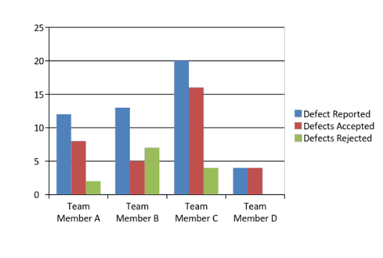
Software Testing Metrics
Software Testing Metrics can be defined as a quantitative measure that helps to make estimates on the software testing projects. It measures the:
Progress
Quality
Health
Test efficiency
And more…
No Testing can be performed without the Software Testing Metrics

Slide 4
What Are Software Test Metrics?
Software test metrics are used to measure the quality of the product.
The metrics also improve the efficiency and effectiveness of a software testing process.
Without the metrics, how do we measure the quality of work done by the testers?
Examples:
How many test cases have been designed per requirement?
How many test cases are yet to design?
How many test cases are executed?
How many test cases are passed/failed/blocked?
How many test cases are not yet executed?
How many defects are identified & what is the severity of those defects?
How many test cases are failed due to one particular defect? etc.

Slide 5

Key Performance Indicators
Key performance indicators (KPI) are the important metrics that are calculated by the software testing teams to ensure the project is moving in the right direction and is achieving the target effectively
Active Defects: Identify the status of defects. Allows the team to resolve them.
Automated Tests: Identify and track the number of the automated tests.
Covered Requirements: Track the % of the requirements covered by at least one test.
Defects Fixed Per Day: keep a track of the number of defects fixed on a daily basis
Percentage of Critical & Escaped Defects: The percentage of critical and escaped defects is an important KPI that needs the attention of software testers
And more….

Slide 6

Test Metrics
Based on the metrics, the Test Lead will get the understanding of the following key points:
% of work completed.
% of work yet to be completed.
When will the remaining work will be complete?
Is the project going as per the schedule?
Is the QA Testing in danger?
Does the QA manager need to add more resources?

Slide 7

Test Metrics Types
Two Types of Test Metrics:
Base Metrics: is the raw data collected by Test Analyst during the test case development and execution
i.e. # of test cases executed, # of test cases).
Calculated Metrics: are derived from the data collected in base metrics. Calculated metrics is usually followed by the test manager for test reporting purpose
% Complete, % Test Coverage

Slide 8
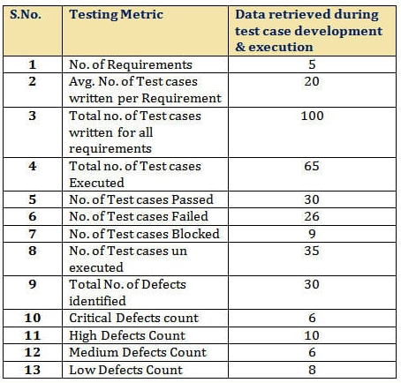
Data From a Test Analyst Performing the Testing

Slide 9
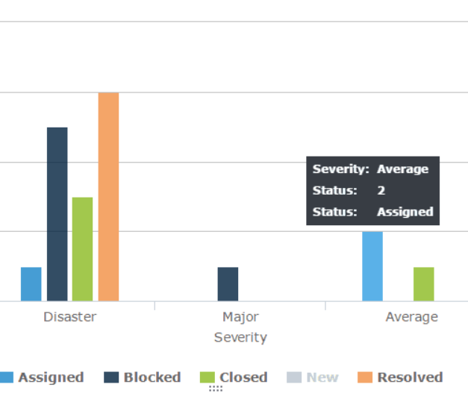
Base and Calculated QA Metrics
Examples of Base Metrics:
No of Test Cases Executed
No of Test Cases Passed/Failed/Blocked
Not of Defects discovered
Examples of Calculated Metrics:
% of Test Cases Executed
% of Test Cases Passed/Failed/Blocked
% of Test cases Remaining
% of Defects Fixed

Slide 10
Test Coverage Metrics
Process Metrics + Product Metrics ➔ Test Coverage Metrics
Process Metrics: Are used to measure and enhance processes of Software Development, Maintenance and Testing.
It is used in the process of test preparation and test execution phase of SDLC.
Product Metrics: It measures the end-product quality built by the development and QA.
It is used in the process of defect analysis phase of SDLC.

Slide 11
Process Metrics
Test Case Preparation Productivity: It is used to calculate the number of Test Cases prepared and the effort spent for the preparation of Test Cases:
(No of Test Case)/ (Effort spent for Test Case Preparation)
EXAMPLE:
No. of Test cases = 240
Effort spent for Test case preparation (in hours) = 10
Test Case preparation productivity = 240/10 = 24 test cases/hour

Slide 12
Process Metrics
Test Design Coverage: It helps to measure the percentage of test case coverage against the number of requirements
((Total number of requirements mapped to test cases) / (Total number of requirements))*100
EXAMPLE:
Total number of requirements: 100
Total number of requirements mapped to test cases: 98
Test Design Coverage = (98/100)*100 = 98%

Slide 13
Process Metrics
Test Execution Productivity: it determines the number of Test Cases that can be executed per hour
(No of Test cases executed)/ (Effort spent for execution of test cases)
EXAMPLE:
No of Test cases executed = 180
Effort spent for execution of test cases (Hours) = 10
Test Execution Productivity = 180/10 = 18 test cases/hour

Slide 14
Process Metrics
Test Execution Coverage: It is to measure the number of test cases executed against the number of test cases planned.
(Total no. of test cases executed / Total no. of test cases planned to execute)*100
EXAMPLE:
Total no. of test cases planned to execute = 240
Total no. of test cases executed = 160
Test Execution Coverage = (160/240)*100 = 75%

Slide 15
Process Metrics
Test Cases Passed: It is to measure the percentage number of test cases passed
(Total no. of test cases passed) / (Total no. of test cases executed) * 100
EXAMPLE:
Test Cases Pass = (80/90)*100 = 88.8 = 89%
Test Cases Failed: It is to measure the percentage no. of test cases failed
(Total no. of test cases failed) / (Total no. of test cases executed) * 100
EXAMPLE:
Test Cases Failed= (10/90)*100 = 11.1 = 11%

Slide 16
Process Metrics
Test Cases Blocked: It is to measure the percentage no. of test cases blocked
(Total no. of test cases blocked) / (Total no. of test cases executed) * 100
EXAMPLE
Test Cases Blocked = (5/90)*100 = 5.5 = 6%

Slide 17
Process Metrics
Effort variance (EV) calculates variance of actual effort versus planned effort.
Effort variance = [(Actual effort- Planned Effort)/Planned effort] * 100.
The effort variance may be greater than expected. For example, we estimated 100 hours but actual work took 110 hours.

Slide 18
Process Metrics
Test effectiveness metrics usually show a percentage value of the difference between the number of defects found by the test team, and the overall defects found for the software.
Test efficiency = (total number of defects found in Unit+Integration+System) / (total number of defects found in Unit+Integration+System+User Acceptance testing)

Slide 19
Test Coverage Metrics
Process Metrics + Product Metrics ➔ Test Coverage Metrics
Process Metrics: Are used to measure and enhance processes of Software Development, Maintenance and Testing.
It is used in the process of test preparation and test execution phase of SDLC.
Product Metrics: It measures the end-product quality built by the development and QA.
It is used in the process of defect analysis phase of SDLC.

Slide 20
Product Metrics
Error Discovery Rate: It is to determine the effectiveness of the test cases.
(Total number of defects found /Total no. of test cases executed)*100
EXAMPLE:
Total no. of test cases executed = 240
Total number of defects found = 60
Error Discovery Rate = (60/240)*100 = 25%

Slide 21
Product Metrics
Defect Fix Rate: It helps to know the quality of a build in terms of defect fixing.
(Total no of Defects reported as fixed - Total no. of defects reopened) / (Total no of Defects reported as fixed + Total no. of new Bugs due to fix)*100
EXAMPLE:
Total no of defects reported as fixed = 10
Total no. of defects reopened = 2
Total no. of new Bugs due to fix = 1
Defect Fix Rate = ((10 – 2)/(10 + 1))*100 = (8/11)100 = 72.7 = 73%

Slide 22
Product Metrics
Defect Density: It is defined as the ratio of defects to requirements.
Defect density determines the stability of the application.
Total no. of defects identified / Size (requirements)
EXAMPLE:
Total no. of defects identified = 80
Actual Size= 10
Defect Density = 80/10 = 8

Slide 23
Software Test Metrics – Product Metrics
Defect Leakage: It is used to review the efficiency of the testing process before UAT. how many defects are missed/slipped during the QA testing
((Total no. of defects found in UAT)/(Total no. of defects found before UAT)) * 100
EXAMPLE:
No. of defects found in UAT = 20
No. of Defects found before UAT = 120
Defect Leakage = (20 /120) * 100 = 16.6 = 17%

Slide 24
Product Metrics
Defect Removal Efficiency: It allows us to compare the overall (defects found pre and post-delivery) defect removal efficiency
((Total no. of defects found pre-delivery) /( (Total no. of defects found pre-delivery )+ (Total no. of defects found post-delivery)))* 100
EXAMPLE
Total no. of defects found pre-delivery = 80
Total no. of defects found post-delivery = 10
Defect Removal Efficiency = ((80) / ((80) + (10)))*100 = (80/90)*100 = 88.8 = 89%

Slide 25
Product Metrics
Defects by Priority: is used to identify the no. of defects identified based on the Severity / Priority of the defect which is used to decide the quality of the software
% Critical Defects = No. of Critical Defects identified / Total no. of Defects identified * 100
% High Defects = No. of High Defects identified / Total no. of Defects identified * 100
EXAMPLE:
Percentage of Critical Defects = 6/ 30 * 100 = 20%

Slide 26
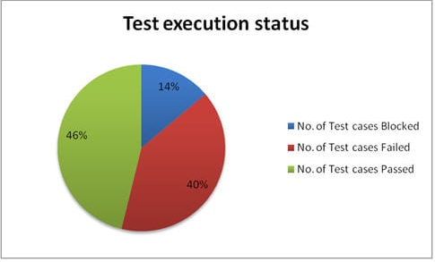
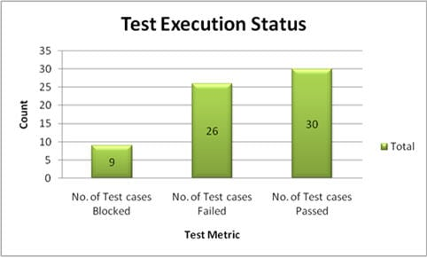
Test Execution Examples

Slide 27
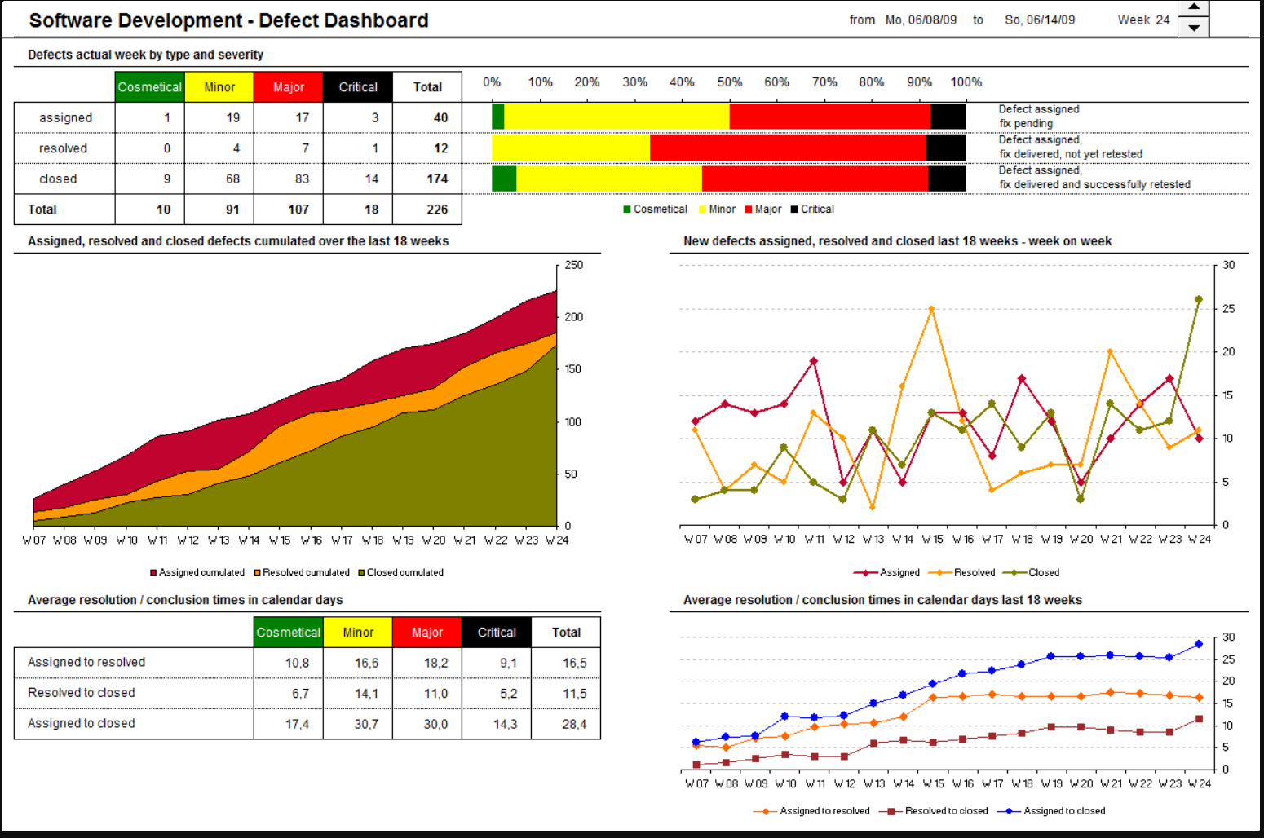

Slide 28

More Process and Product Metrics
Rework Effort Ratio = (Actual rework efforts spent in that phase/ total actual efforts spent in that phase) X 100
Requirement Creep = ( Total number of requirements added/No of initial requirements)X100
Schedule Variance = ( Actual efforts – estimated efforts ) / Estimated Efforts) X 100
Cost of finding a defect in testing = ( Total effort spent on testing/ defects found in testing)
Schedule slippage = (Actual end date – Estimated end date) / (Planned End Date – Planned Start Date) X 100
Fixed Defects Percentage = (Defects Fixed/Defects Reported) X 100
Accepted Defects Percentage = (Defects Accepted as Valid by Dev Team /Total Defects Reported) X 100
Defects Deferred Percentage = (Defects deferred for future releases /Total Defects Reported) X 100

Slide 29
More Process and Product Metrics
Critical Defects Percentage = (Critical Defects / Total Defects Reported) X 100
Average time for a development team to repair defects = (Total time taken for bugfixes/Number of bugs)
Number of tests run per time period = Number of tests run/Total time
Test design efficiency = Number of tests designed /Total time
Test review efficiency = Number of tests reviewed /Total time
Requirement stability index (RSI) = is a metric used to organize, control, and track changes to the originally specified requirements for a new system project or product.
Bug find rate or Number of defects per test hour = Total number of defects/Total number of test hours

Slide 30
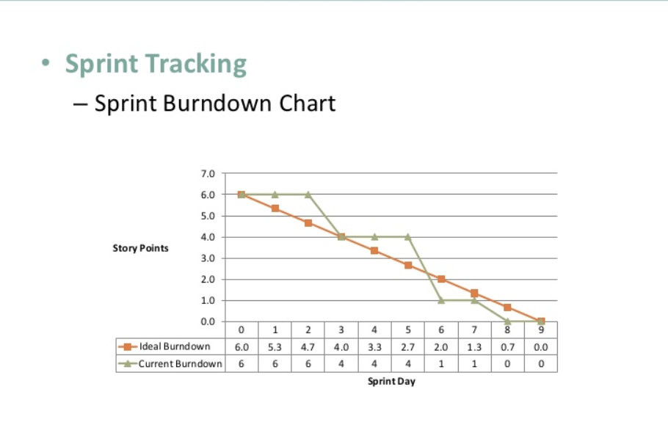
Agile Test Metrics
Sprint burndown – How much work is remaining in the current iteration, and how much testing remains to be done.
https://www.sealights.io/test-metrics/

Slide 31
4 Types of Burndown Charts
Product burndown chart: A graph which shows how many Product Backlog Items (User Stories) implemented/not implemented.
Sprint burndown chart: A graph which shows how many Sprints implemented/not implemented by the Scrum Team.
Release burndown chart: A graph which shows list of releases still pending, which Scrum Team have planned.
Defect burndown chart: A graph which shows how many defects identified and fixed.

Slide 32
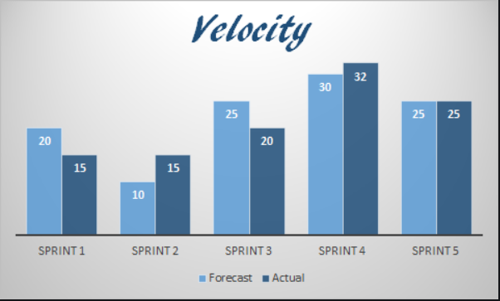
Agile Test Metrics
Number of working tested features / running tested features – The more features or agile “stories” are consistently added to the software and fully tested, the healthier the project.
Velocity – The speed at which the development team is completing new features.
It predicts how much work an agile software development team can successfully complete within a sprint and how much time will it need to finish a project.
https://www.sealights.io/test-metrics/

Slide 33
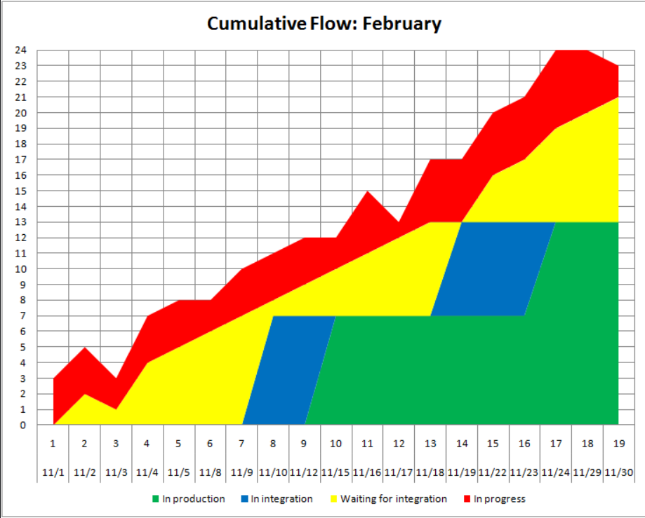
Agile Test Metrics
Cumulative flow – Helps visualize bottlenecks in the agile process.
In particular, helps teams visualize if testing resources are adequate and if testing is slowing down the development cycle.
https://www.sealights.io/test-metrics/

Slide 34
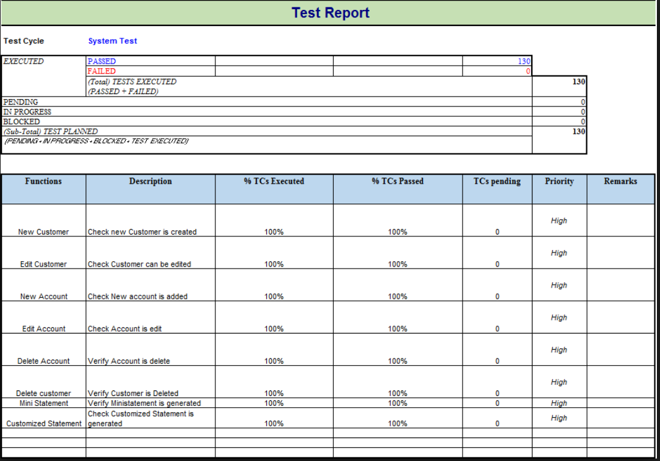

Slide 35

References
https://www.softwaretestinghelp.com/software-test-metrics-and-measurements/
NeilPatel.com
Guru99.com
https://www.softwaretestingmaterial.com/test-metrics/#ProcessMetrics

